Slide 1

INTERNATIONAL INSTITUTE OF INFORMATION TECHNOLOGY, NAYA RAIPUR Department of Data Science and Artificial Intelligence
AIR WRITING DETECTION AND RECOGNITION

Slide 2
GROUP MEMBERS
Abhishek Chaudary - 191020403
Khushi Agrawal - 191020429
Prabhat Kumar – 191020438
Under the Guidance of – Dr. Abhishek Sharma
Department of DSAI, DSPM IIIT-NR

Slide 3
Table of Content
Introduction of the Problem
What is the state of the art
Proposed Methodology
Recap
What we did in the End-Sem
Department of DSAI, DSPM IIIT-NR

Slide 4
Introduction of the Problem
Imagine visualizing the Unseen and the Unspoken!
15% of the global population has some form of disability among which 2-4% have significant disability in basic functioning.
We can't help everyone but, can help a significant few .
Older Adults and some Young Adults lacks of Kūsho effect
People who are Hyperlexic.
People loosing auditory perception over time.
Young minds which heavily rely cognitive perception
Department of DSAI, DSPM IIIT-NR

Slide 5
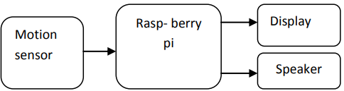
State of the Art (Literature Review)
An Optimized Approach for Deaf and Dumb people using Air writing by “Nithya.S”, “Chandru.S”, “Krishnakanth.G” and “Pavithran.P”
Color is selected using HSV
Project was based on RaspberryPi and motion sensor.
Object is detected using Morphological Masking and Contours
Characters are recognized using two methods OCR and Comparison
Fig: Block diagram of proposed system
Department of DSAI, DSPM IIIT-NR

Slide 6
Proposed Methodology
Writing in Air
Color Selector
Morphological Operations for Masking
Contour
Paint Sheet
Live Tracker
Recognition
CNN
Department of DSAI, DSPM IIIT-NR

Slide 7

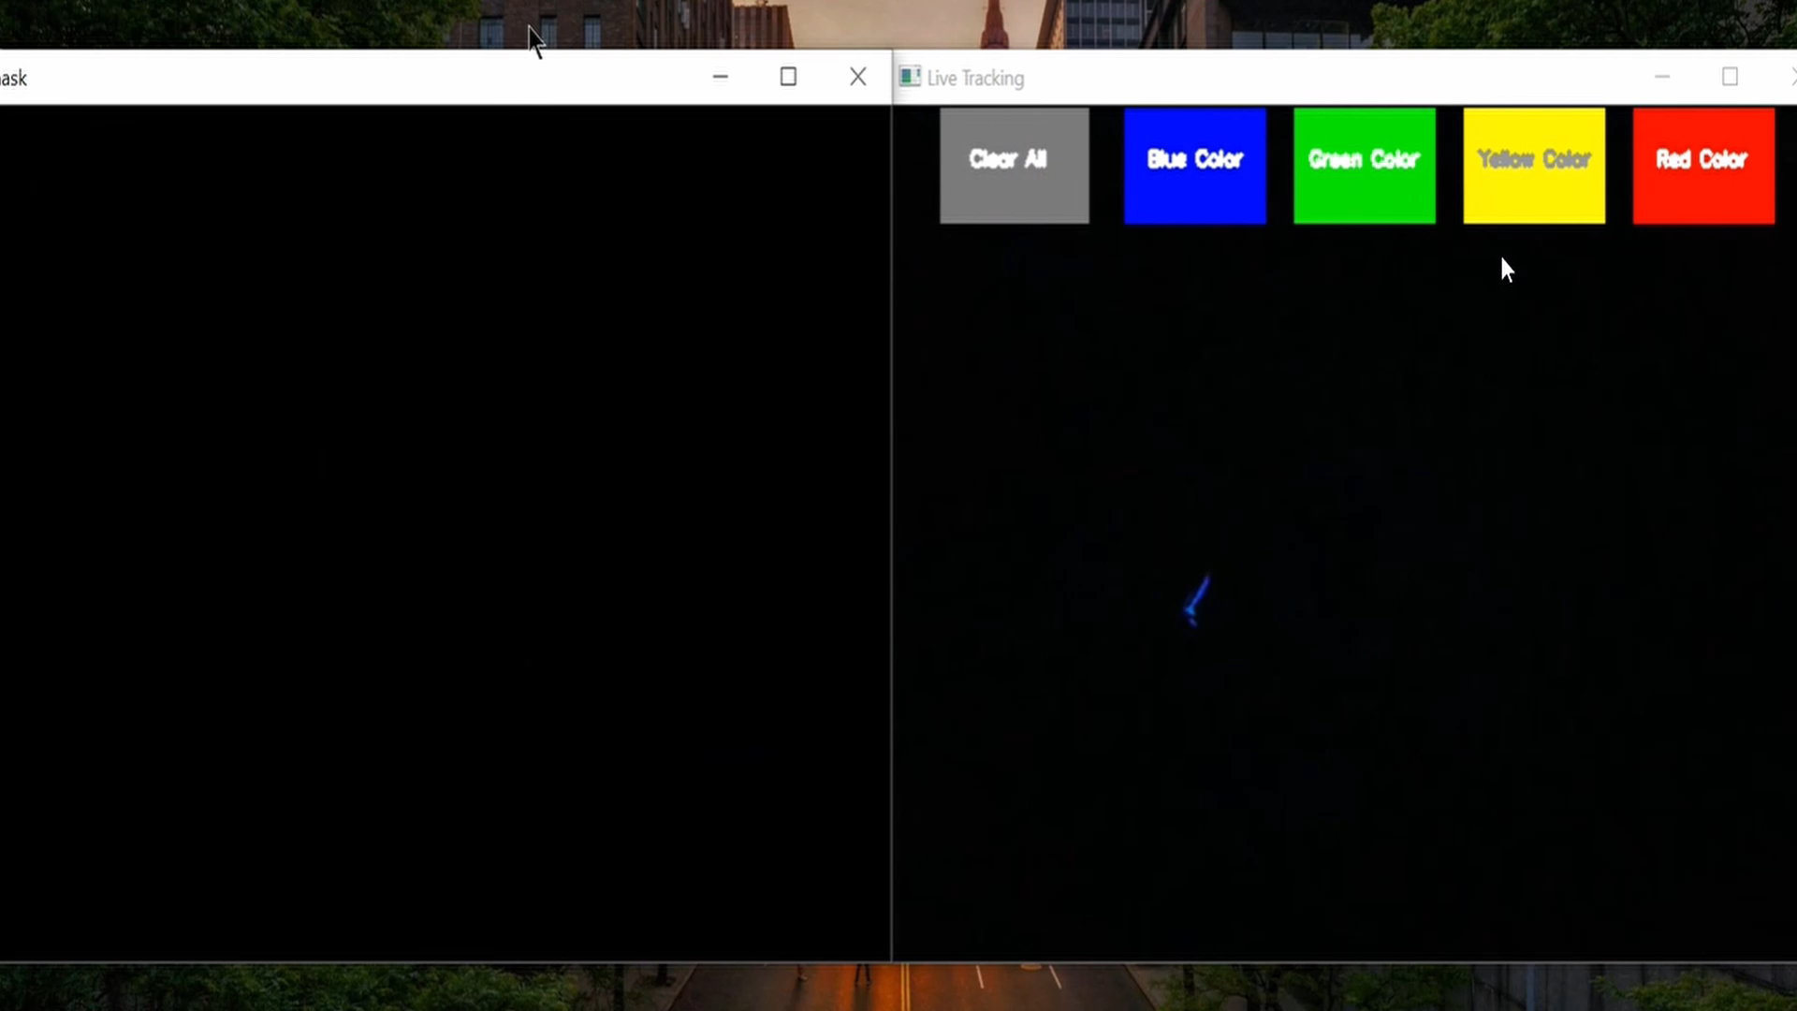
Writing in air
Department of DSAI, DSPM IIIT-NR

Slide 8
What we have done till Mid Semester
Air Writing detection
Color Selection
Color Selector
Selection of color using HSV selector.
Masking
Erosion
Creating a paint sheet
Live Tracking
Masking
Paint Sheet
Dilation
Live Tracker
5 OSD buttons for color changing and Clearing the screen
Live preview from the camera
Storing location data of the pixels taken from the camera to create a continuous line.
Contour
Creation of contour
Finding the centroid of contour
Contour
Department of DSAI, DSPM IIIT-NR

Slide 9
What we have done after Mid Semester
Writing Recognition
Convolutional Neural Network
Department of DSAI, DSPM IIIT-NR

Slide 10
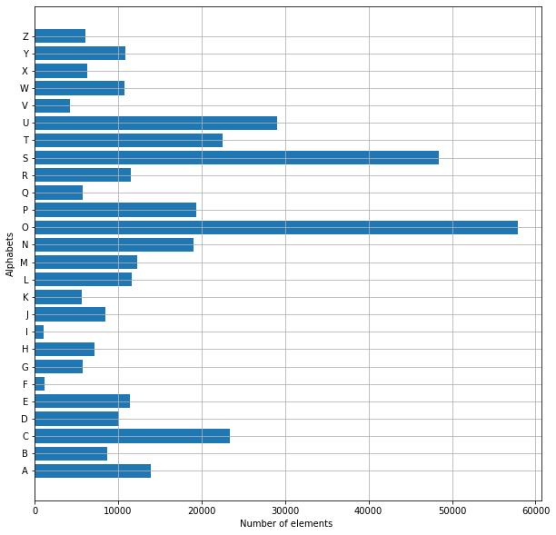
Dataset Description
Dataset- https://www.kaggle.com/sachinpatel21/az-handwritten-alphabets-in-csv-format
Total no. of characters- 26 folders (size - 28 x 28)
Gray scale image
Split into- 20-80%
Train data shape: (297960, 28, 28)
Test data shape: (74490, 28, 28)
Department of DSAI, DSPM IIIT-NR

Slide 11
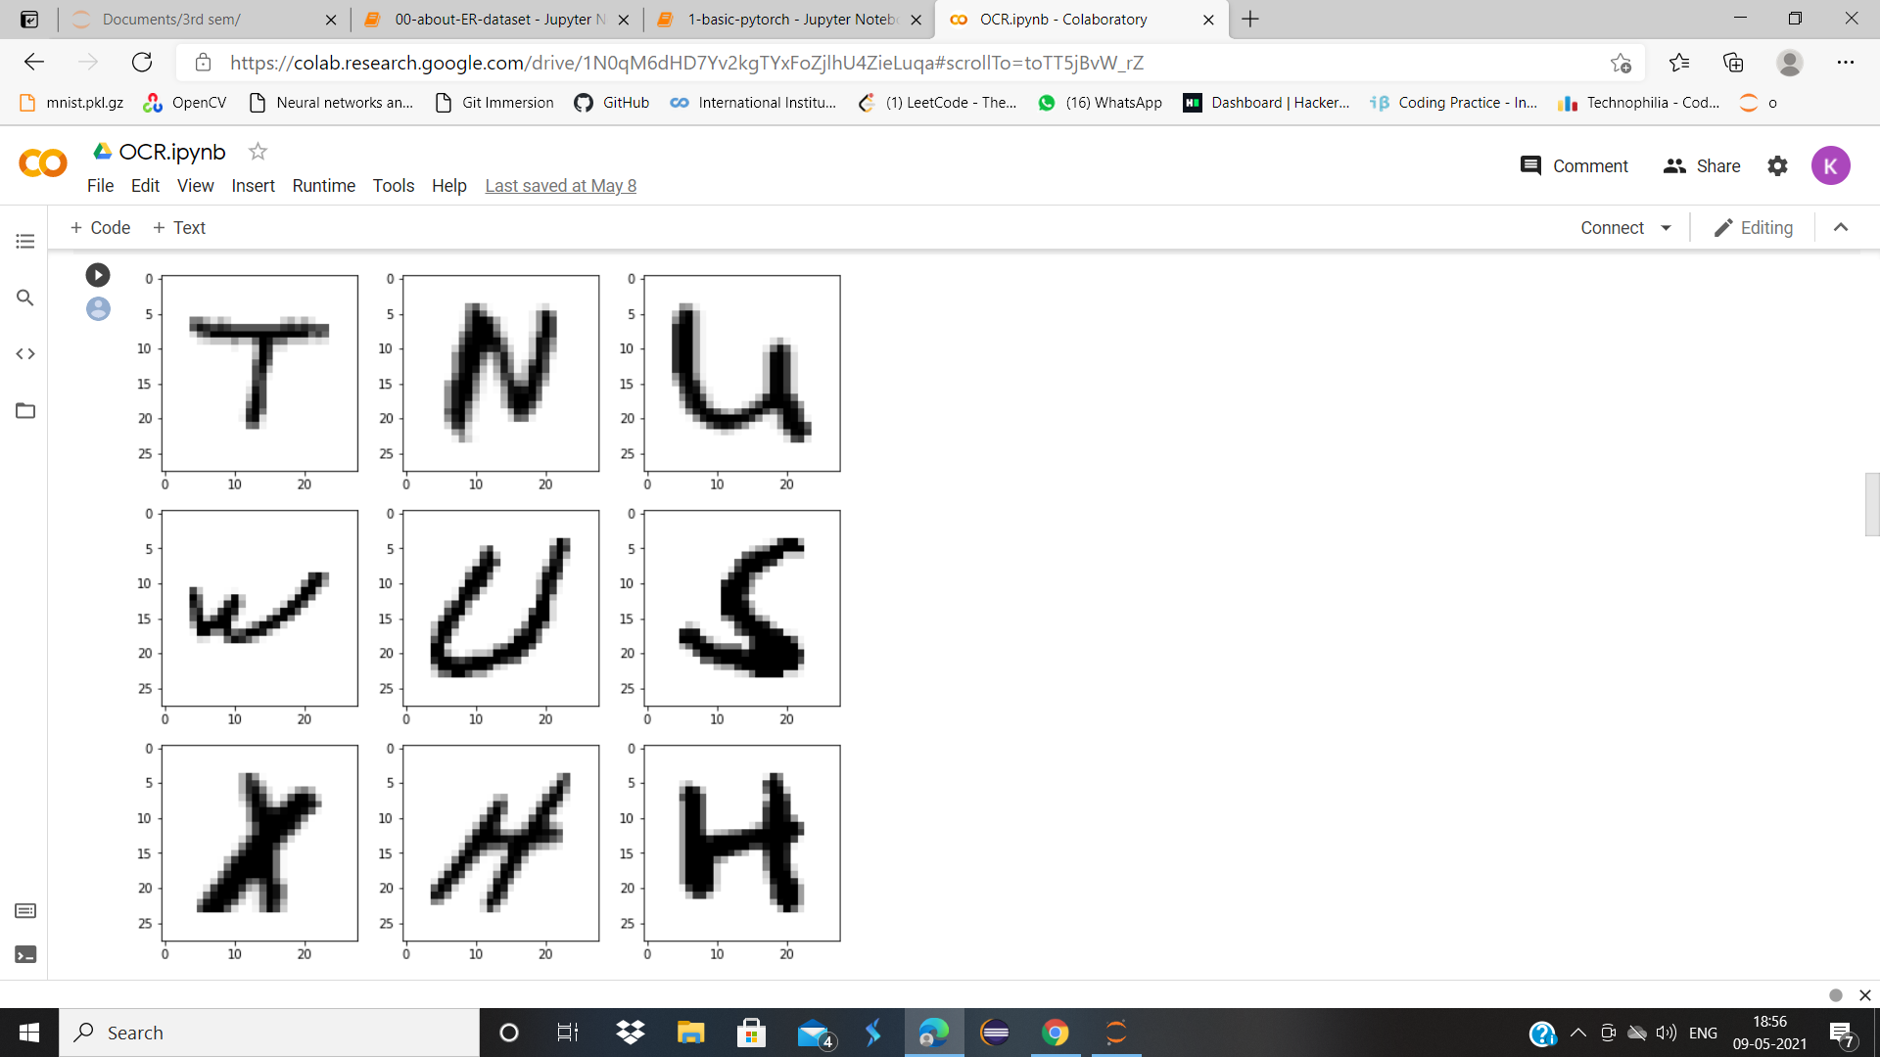
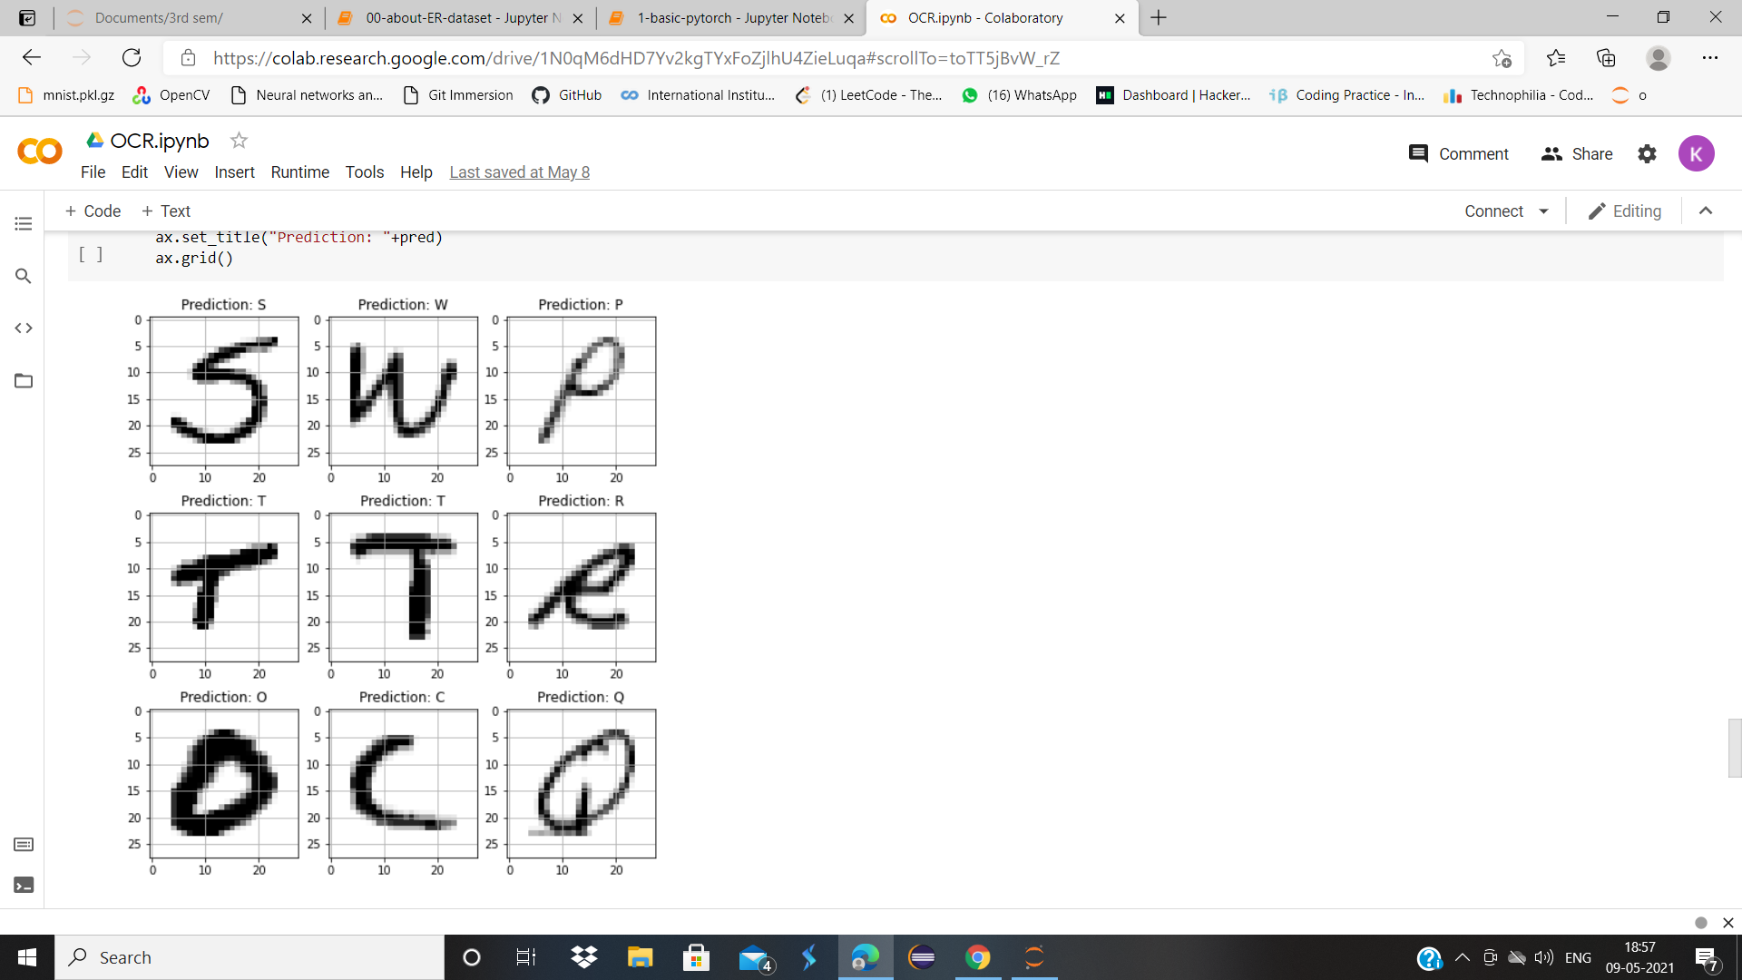
Training and Testing Dataset
Train Data
Test Data
Department of DSAI, DSPM IIIT-NR

Slide 12
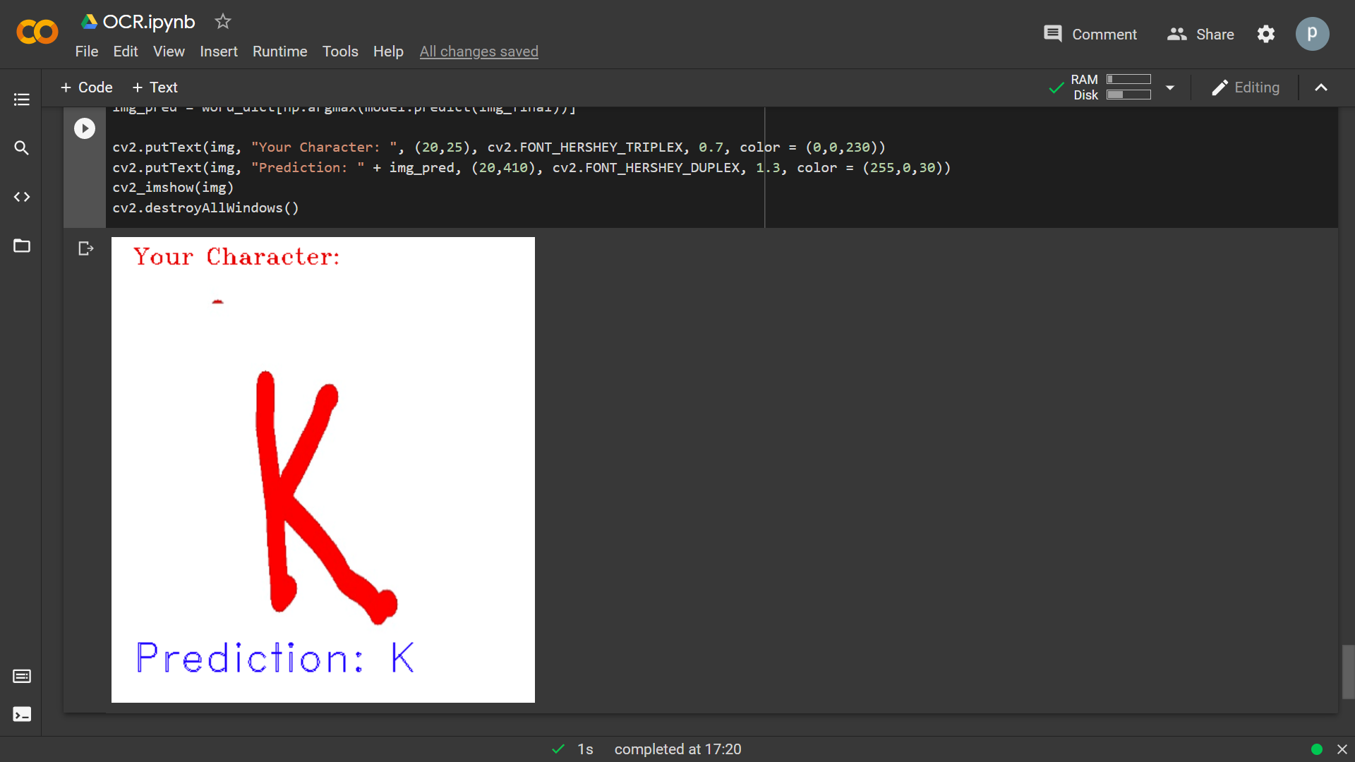
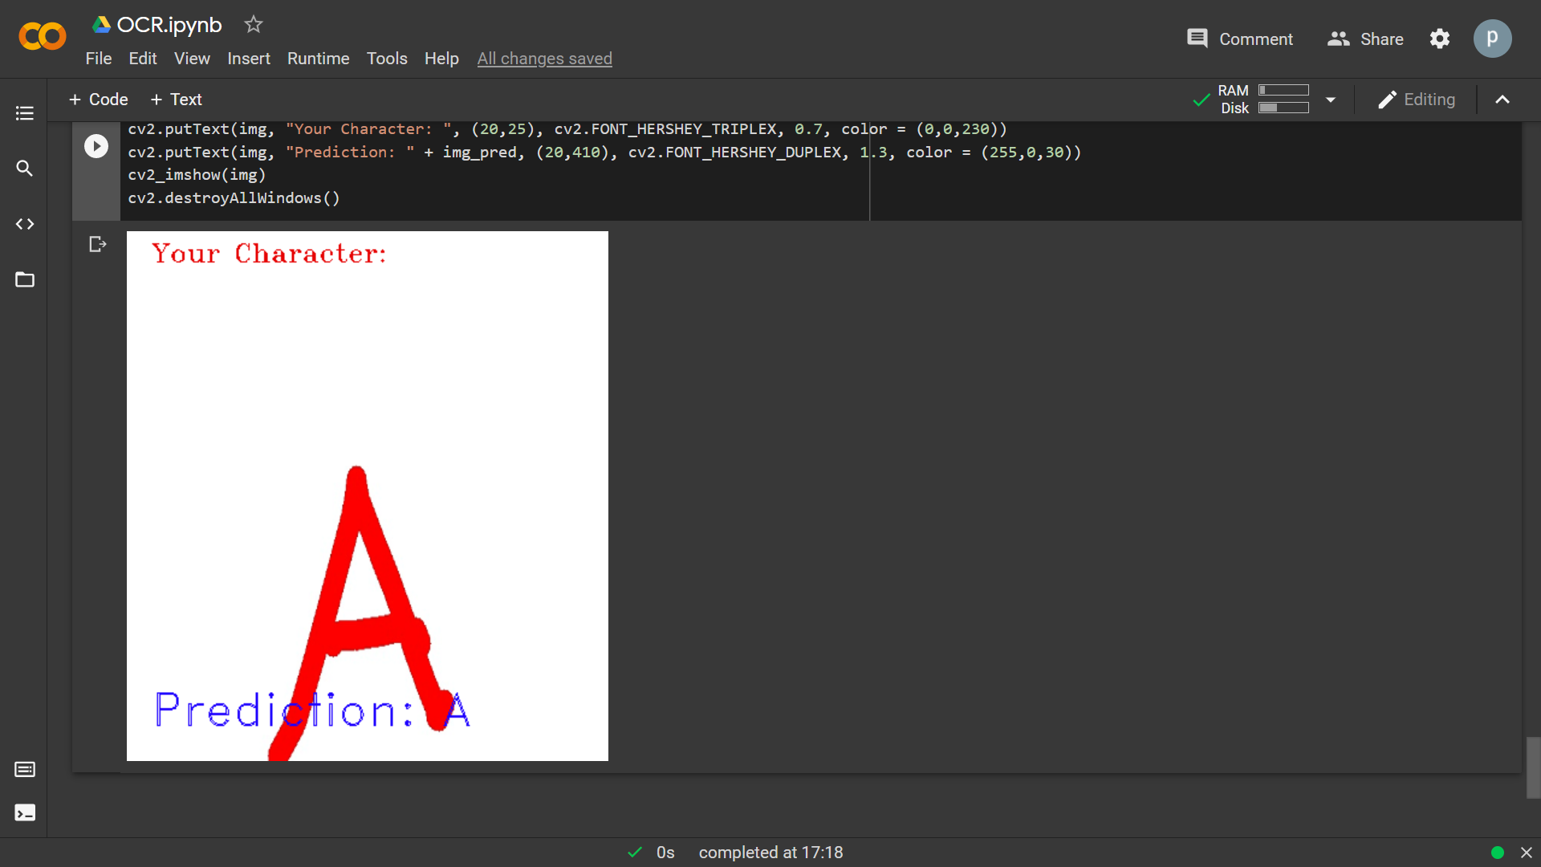
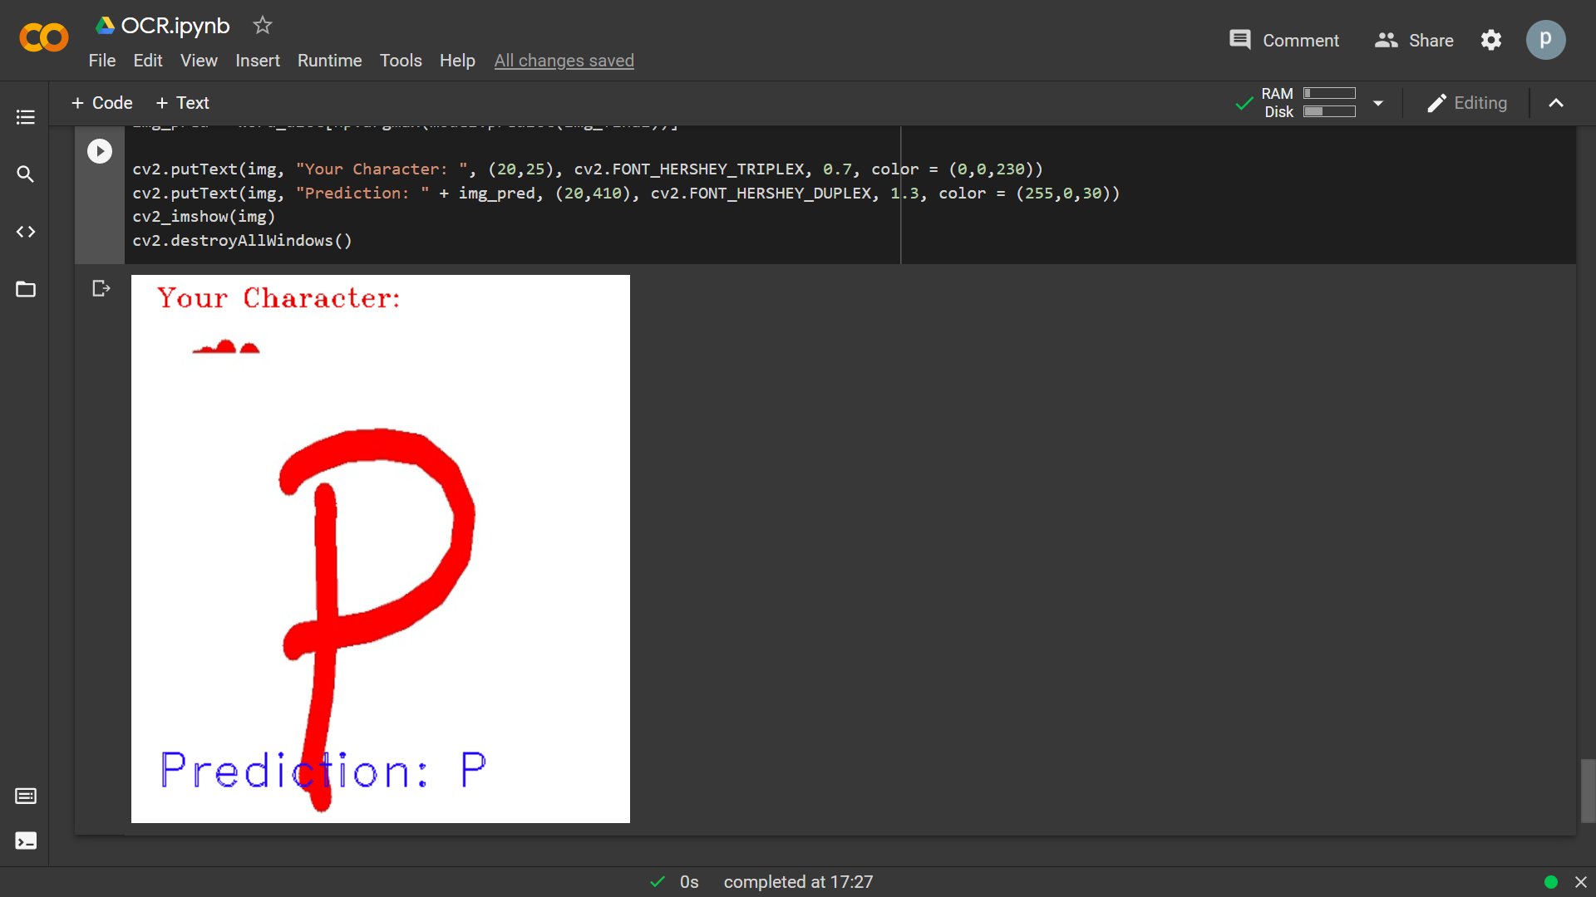
Recognition
Department of DSAI, DSPM IIIT-NR

Slide 13

CNN Architecture– Convolutional Layer
Model Used- Sequential
What is Convolution?
Basic Ideology of Convolution Layer:
Detect edges of required feature
Detect parts of the object
Club all into one
Example of Convolution
Department of DSAI, DSPM IIIT-NR

Slide 14
Padding And Strides
Padding
Adding rows and columns to given input image
Why Padding?
To prevent data loss
Ensure output does not shrink
Types of padding:
Valid Padding- Means no padding, assumes all dimensions as valid.
Same Padding- Zero padding, used when we want shape of input image and output image is same. Here, p = (f-1)/2
Size of output matrix: n+2p-f+1, n+2p-f+1
Department of DSAI, DSPM IIIT-NR

Slide 15
CONTD...
Strides
Tells how much rows and columns it should jump
Size of matrix- (n+2p-f)/s + 1, (n+2p-f)/s + 1.
Uses- Controlls how the filter convolves around the input image
Department of DSAI, DSPM IIIT-NR

Slide 16


Padding and Strides Demonstration
Convolution, Same Padding, And With Strides = 2
Convolution, Not Same Padding, With Strides = 1
Department of DSAI, DSPM IIIT-NR

Slide 17
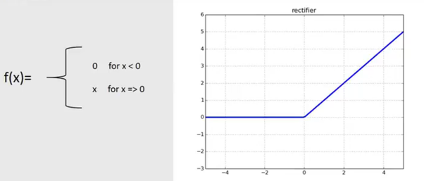
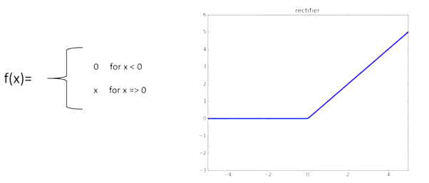
Activation Function- ReLU, SoftMax
ReLU
Stands for rectified activation function
Used when hidden layer are completely unknown
Speed and Accuracy- Fast and more accurate
Department of DSAI, DSPM IIIT-NR

Slide 18

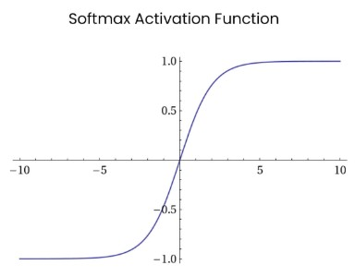
CONTD...
SoftMax
Used in output layer
For Multiclass prediction
Department of DSAI, DSPM IIIT-NR

Slide 19
Pooling layer
The entire image mapping done by the kernels is summarized here.
This reduces the dimensions of the feature maps.
There are 3 types of pooling – Max , Average and Global.
We used Max pooling in our project.
The function used for this purpose in the code is : MaxPool2D()
Department of DSAI, DSPM IIIT-NR

Slide 20

Pooling Demonstration
The max pooling visualization
Department of DSAI, DSPM IIIT-NR

Slide 21
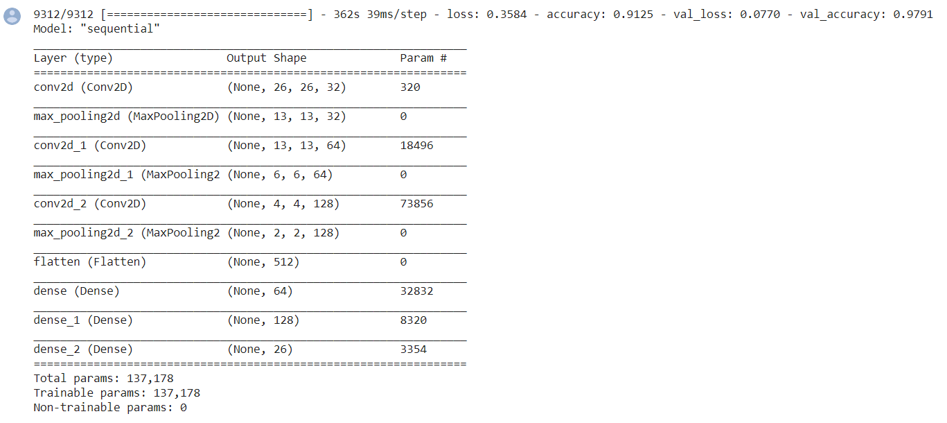
Results
The validation accuracy is : [0.9791381359100342]
The training accuracy is : [0.9573432803153992]
The validation loss is : [0.07700876146554947]
The training loss is : [0.15533433854579926]
Department of DSAI, DSPM IIIT-NR

Slide 22
What we have done
CNN
Convolutional layer
Padding and Strides
Activation Function
Pooling
Convolutional Layers
Padding
Valid Padding
Same Padding
Strides
Activation Function
ReLU
SoftMax
Pooling
Max Pooling
Average Pooling
Global Pooling
Department of DSAI, DSPM IIIT-NR

Slide 23
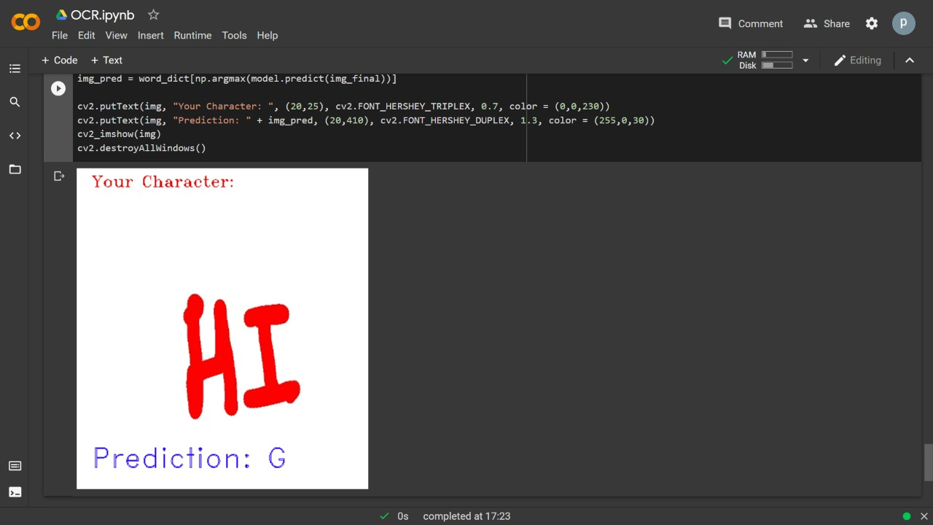
Limitations
Two-step process
Unable to integrate detection and recognition in one frame
Not fully gesture controlled
Accuracy- Unable to recognize more than 1 character
Only Alphabets, Digits are not recognized
We can see that ‘HI’ is predicted as ‘G’
Department of DSAI, DSPM IIIT-NR

Slide 24
THANK YOU

